Slide 1

Project 5 Object Detection In Point Cloud : Lane Marking
Kunal Dhande A20369862
Kunal Kolhatkar A20373885

Slide 2
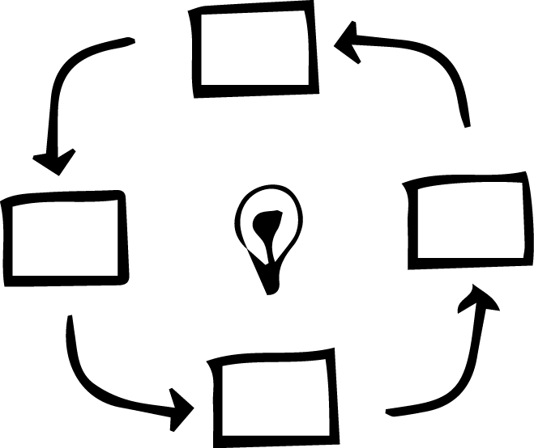
OVERVIEW

Slide 3
OVERVIEW
What is Point Cloud?
Point clouds usually created by 3D scanners, is a set of data points intended to represent the external surface of an object.
In our case we have a point cloud file with 4,30,736 point defined as
[latitude] [longitude] [altitude] [intensity]
45.90388 11.028413 232.4648 10
45.90368 11.028220 234.4706 5
What do we do with it?
We detect objects in such a Point Cloud.

Slide 4

TASK

Slide 5
TASK
What do we have to in this project?
The objective of this project is to design a Lane detection algorithm.
Representation of those detected Lanes using Line segment.

Slide 6


Slide 7
1. Convert Cloud point into X, Y and Z coordinate system based on intensity
2. Use these points to create a Binary Image
3. Perform different operations on this Binary Image to detect and mark Lane

Slide 8
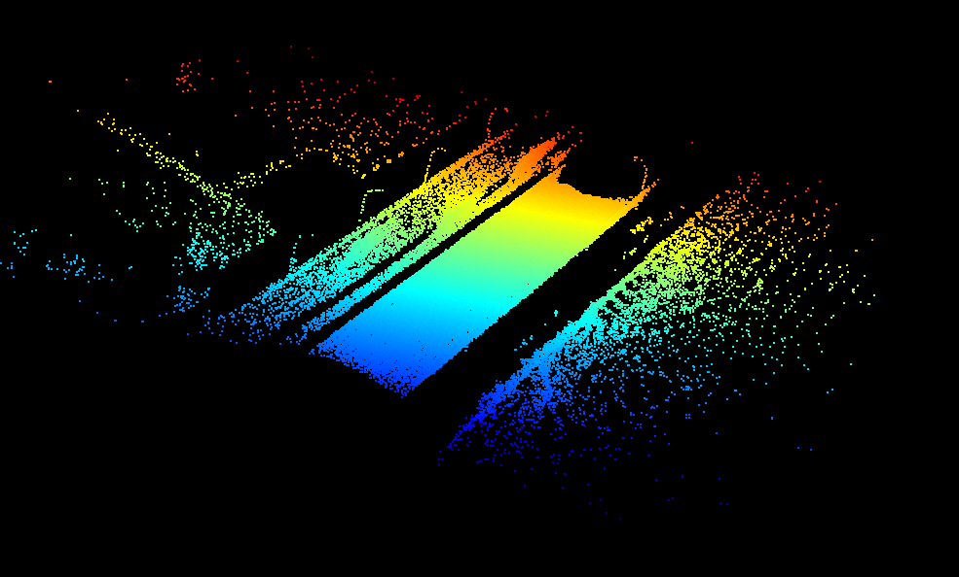
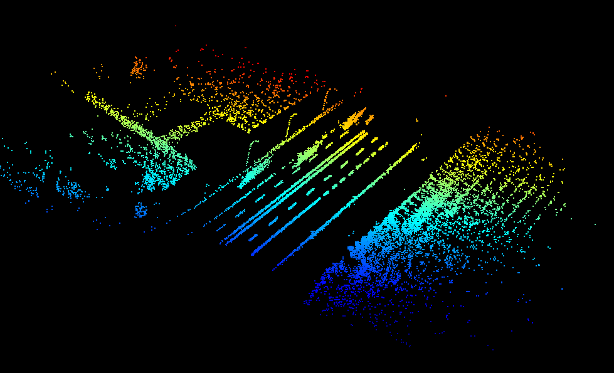
Visualization of cloud points with different intensity
ALL 430736 Points
Points with Intensity > 20 – 31017 Points

Slide 9
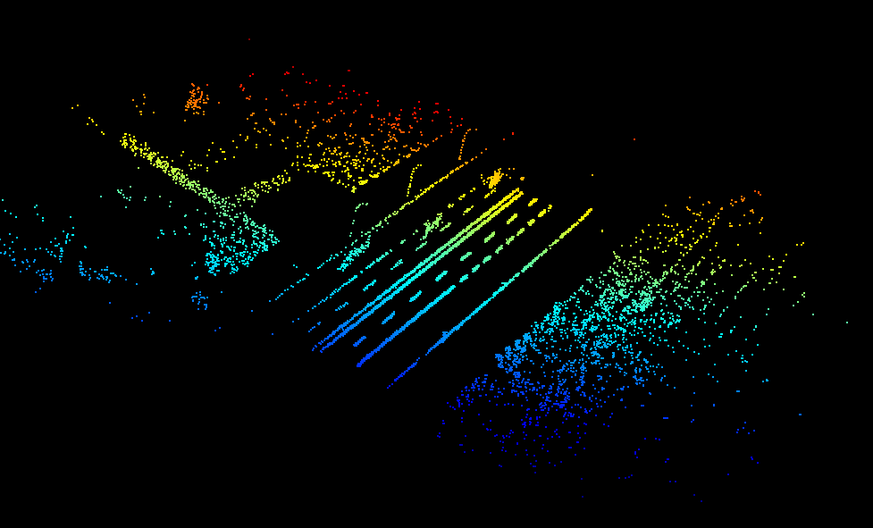
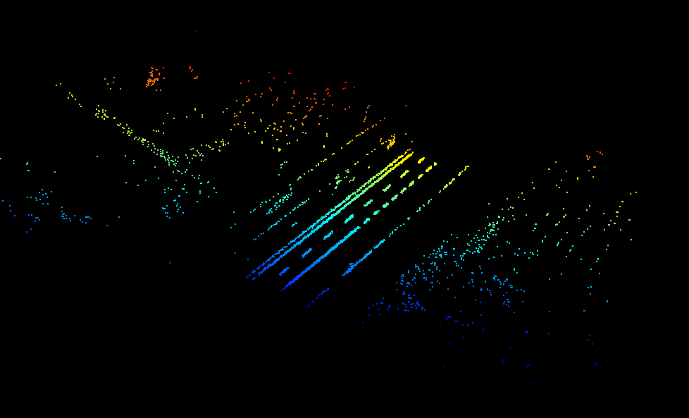
Visualization of cloud points with different intensity
Points with Intensity > 30 – 18618 Points
Points with Intensity > 50 – 8484 Points

Slide 10

Using the point who has intensity > 50 to create a Binary Image
Used the matplotlib to convert points from Cloud Points to X, Y and Z coordinate Sysytem.
And to plots these points

Slide 11


Different operations on Binary Image to detect and mark Lane
1. Convert the image to GrayScale the Image
WHY?? -> Since color information doesn't help us much to identify important edges or other features we convert the image to grayscale image
2. Blur the Image
WHY?? → Since all edge detection results are easily affected by image noise, it is essential to filter out the noise to prevent false detection caused by noise. To smooth the image, we blur the image first.

Slide 12

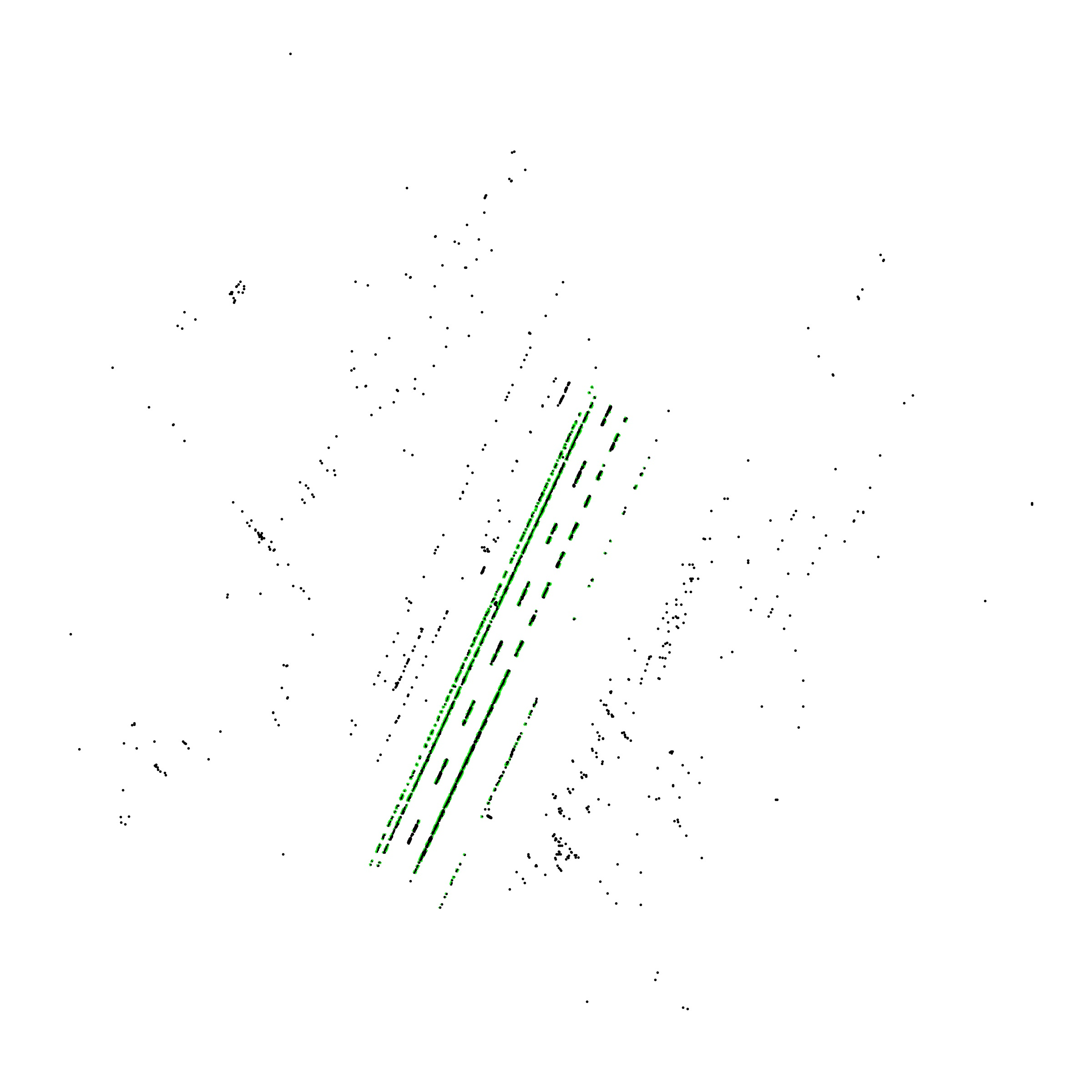
Different operations on Binary Image to detect and mark Lane
3. Perform Canny Operation
WHY?? -> Canny is and Edge Detector operation to detect the edges in the image.
4. Perform Hough transform
WHY?? -> This is used to detect lines in the image generated after canny operation

Slide 13
REFERENCES
Class Notes –Lecture 7
http://ieeexplore.ieee.org.ezproxy.gl.iit.edu/document/6957753/
http://ieeexplore.ieee.org.ezproxy.gl.iit.edu/document/7479026/

